Slide 1

CGC_REBOUNDER Team member Bhawna Rajput(Captain)-Android Developer Himanshu Kumar-Embedded Developer Surendra Singh Hada-Embedded Developer

Slide 2

INSTALLATION GUIDE

Slide 3
Technology Used
Android Studio-JAVA
Real Term Software for Testing the cases
Embedded Hardware Device
Chipset HC 05
Chipset Coding in Python

Slide 4
Android Studio
Hardware and Software specification:-
Windows OS
Microsoft Windows 7/8/10 (32-bit or 64-bit)
2 GB RAM minimum, 8 GB RAM recommended.
2 GB of available disk space minimum, 4 GB Recommended (500 MB for IDE + 1.5 GB for Android SDK and emulator system image)
1280 x 800 minimum screen resolution.
JDK 8.

Slide 5
Real Term Software
Real Term is Basically used to check test cases ,to interact with software on your PC, not with a physical port as normal, the you need com0com .
This makes a pair of virtual comports, linked together.
You softwareconnects to one port, and Realterm connects to the other.
Now Realterm can talk to your software and see what it is sending.
We have used this for Checking the test case with Our Android App in order to check the Fuctionality with HC 05 bluetooth chipset

Slide 6
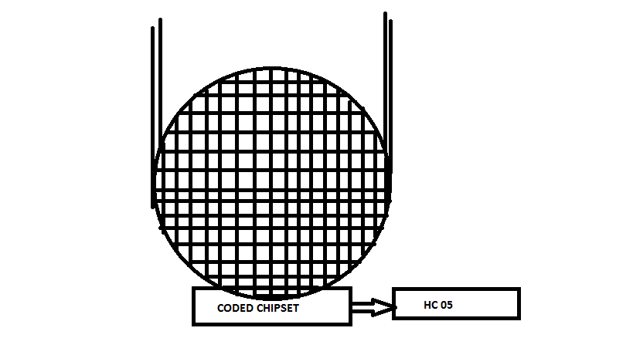
Embedded Hardware Device
Basically we have used this in order to Provide
Functionality to all the vehicles
It has to be embedded inside the Petrol Tank
And the attached Coded chipset
Will starts working
When Ever the Petrol will starts Flow
After Completing the Coding Part the output and the calculated result will be
Transferred through HC 05 Bluetooth chipset
Formula Used in the Chipset:- avg rate of flow = volume passed
time passed

Slide 7
Chipset
HC 05 chipset is Used for the Transfer and sharing Functionality
Coded Chipset is present There where we will embedded our Python Code to Calculate the Function Data and transfer to the HC 05
Which in returns Provide data in our Output Mobile Screen

